Slide 1
Telecom Churn Prediction
Capstone Project

Slide 2
Business Problem & Objective
In the competitive telecom industry, churn rates reach 15–25% annually. Retaining high-value customers is critical since acquiring new ones costs 5–10x more.
Objective: Predict churn among high-value prepaid customers and identify key drivers, enabling targeted retention strategies.

Slide 3
Approach
1. Data Preparation:
• Filtered high-value customers (top 30% by recharge amount)
• Defined churn using zero usage in month 9 (calls & data)
• Removed churn phase features
2. Exploratory Data Analysis (EDA):
• Univariate and bivariate analysis
• Identified churn rate and key patterns
3. Modeling:
• Logistic Regression with multicollinearity handling
• Feature importance analysis
4. Insights & Recommendations

Slide 4
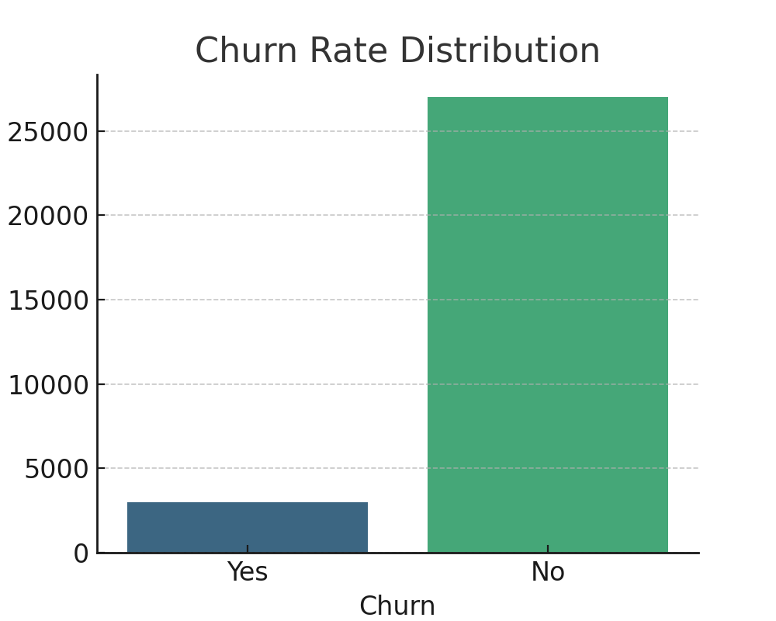
Churn Rate Distribution

Slide 5
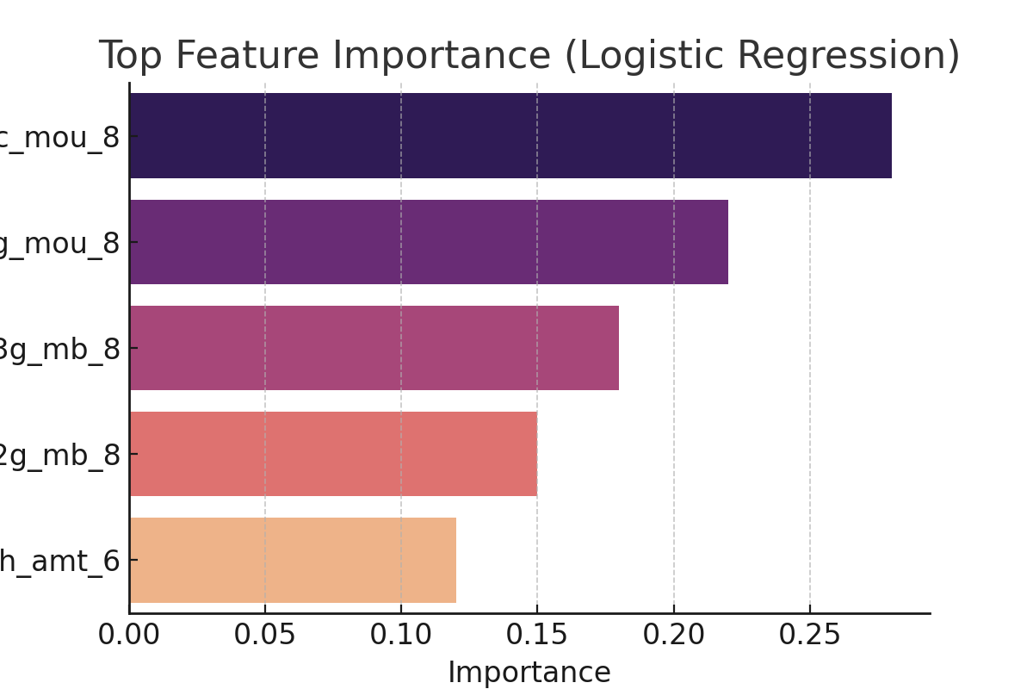
Top Predictors of Churn

Slide 6
Conclusion & Recommendations
• Churn rate among high-value customers is significant, requiring proactive retention.
• Key churn predictors: drop in usage (IC/OG minutes, 2G/3G data), lower recharge amounts.
• Recommendations:
– Target at-risk customers in 'action' phase with offers and improved service.
– Monitor usage patterns for early warning.
– Invest in customer experience to reduce churn.

